Slide 1

Chapter 9:
Pointers

Slide 2
Pointers to Constants
If we want to store the address of a constant in a pointer, then we need to store it in a pointer-to-const.

Slide 3

Pointers to Constants
Example: Suppose we have the following definitions:
const int SIZE = 6;
const double payRates[SIZE] =
{ 18.55, 17.45, 12.85,
14.97, 10.35, 18.89 };
In this code, payRates is an array of constant doubles.

Slide 4
Pointers to Constants
Suppose we wish to pass the payRates array to a function? Here's an example of how we can do it.
void displayPayRates(const double *rates, int size)
{
for (int count = 0; count < size; count++)
{
cout << "Pay rate for employee " << (count + 1)
<< " is $" << *(rates + count) << endl;
}
}
The parameter, rates, is a pointer to const double.

Slide 5
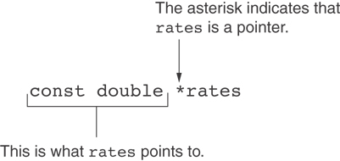
Declaration of a Pointer to Constant

Slide 6
Constant Pointers
A constant pointer is a pointer that is initialized with an address, and cannot point to anything else.
Example
int value = 22;
int * const ptr = &value;

Slide 7
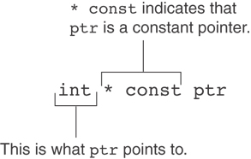
Constant Pointers

Slide 8
Constant Pointers to Constants
A constant pointer to a constant is:
  a pointer that points to a constant
  a pointer that cannot point to anything except what it is pointing to
Example:
int value = 22;
const int * const ptr = &value;

Slide 9
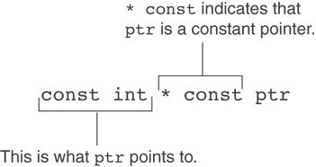
Constant Pointers to Constants

Slide 10
9.8
Dynamic Memory Allocation

Slide 11
Dynamic Memory Allocation
Can allocate storage for a variable while program is running
Computer returns address of newly allocated variable
Uses new operator to allocate memory:
  double *dptr = nullptr;
  dptr = new double;
new returns address of memory location

Slide 12
Dynamic Memory Allocation
Can also use new to allocate array:
const int SIZE = 25;
arrayPtr = new double[SIZE];
Can then use [] or pointer arithmetic to access array:
  for(i = 0; i < SIZE; i++)
  *arrayptr[i] = i * i;
  or
  for(i = 0; i < SIZE; i++)
  *(arrayptr + i) = i * i;
Program will terminate if not enough memory available to allocate

Slide 13
Releasing Dynamic Memory
Use delete to free dynamic memory:
  delete fptr;
Use [] to free dynamic array:
  delete [] arrayptr;
Only use delete with dynamic memory!

Slide 14
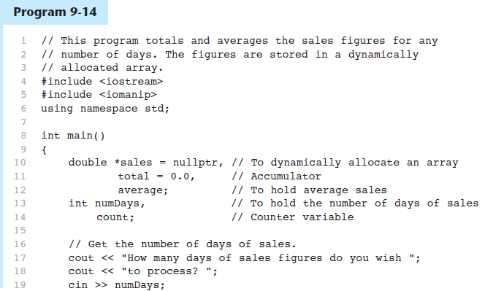
Dynamic Memory Allocation in Program 9-14

Slide 15
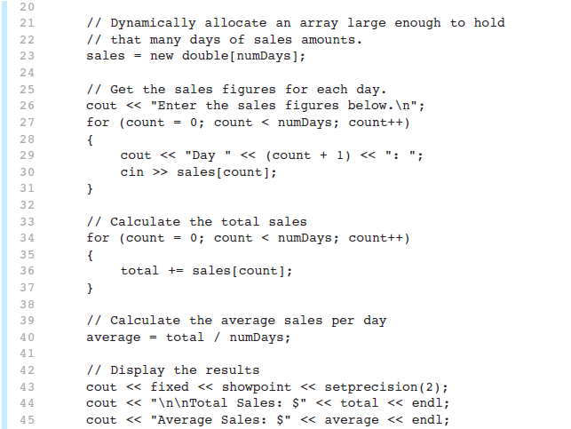
Dynamic Memory Allocation in Program 9-14
Program 9-14 (Continued)

Slide 16
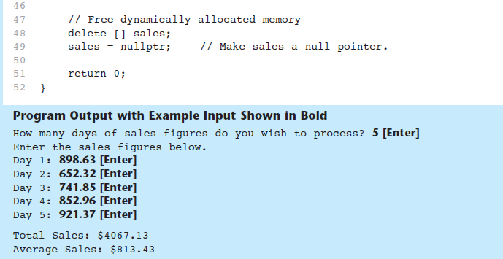
Dynamic Memory Allocation in Program 9-14
Program 9-14 (Continued)
Notice that in line 49 nullptr is assigned to the sales pointer. The delete operator is designed to have no effect when used on a null pointer.

Slide 17
9.9
Returning Pointers from Functions

Slide 18
Returning Pointers from Functions
Pointer can be the return type of a function:
  int* newNum();
The function must not return a pointer to a local variable in the function.
A function should only return a pointer:
  to data that was passed to the function as an argument, or
  to dynamically allocated memory

Slide 19
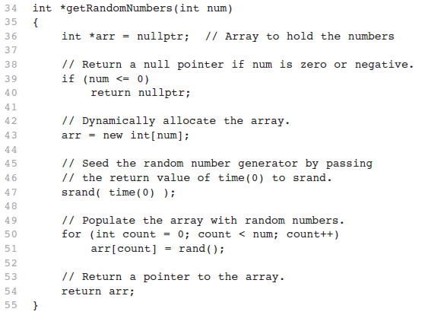
From Program 9-15

Slide 20
9.10
Using Smart Pointers to Avoid Memory Leaks

Slide 21
Using Smart Pointers to Avoid Memory Leaks
In C++ 11, you can use smart pointers to dynamically allocate memory and not worry about deleting the memory when you are finished using it.
Three types of smart pointer:
Must #include the memory header file:
In this book, we introduce unique_ptr:
unique_ptr
shared_ptr
weak_ptr
#include <memory>
unique_ptr<int> ptr( new int );

Slide 22
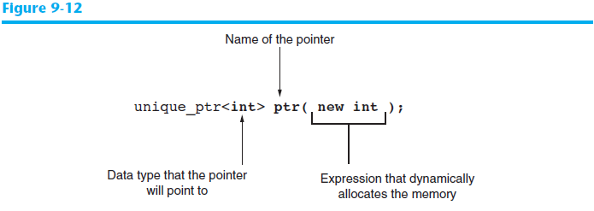
Using Smart Pointers to Avoid Memory Leaks
The notation <int> indicates that the pointer can point to an int .
The name of the pointer is ptr .
The expression new int allocates a chunk of memory to hold an int.
The address of the chunk of memory will be assigned to ptr.

Slide 23
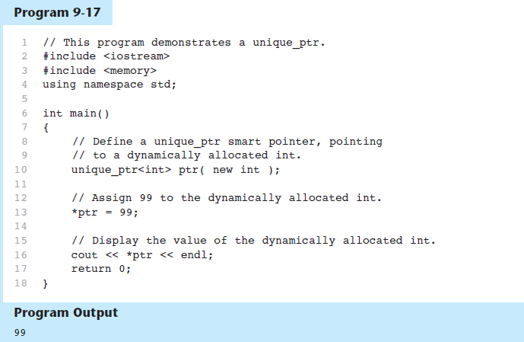
Using Smart Pointers in Program 9-17

